Slide 1

Department of Computer Engineering
UM Browser
A simple, fast and lightweight browser with all necessary required features.
Guided By
- Prof. Rupali Pawar
Team Members
Nilesh Tale
Nikhil Thapa
Rohan Mandhare
Shivam Singh
T150524349
T150524299
T150524321
T150524341
Indira College of Engineering & Management, Pune

Slide 2

Team Contribution
01
Nilesh Tale
Login and database connectivity
02
Shivam Singh
Main Layout and Private Window
03
Nikhil Thapa
App Integrations
04
Rohan Mandhare
Menu Window

Slide 3
Table of Contents
01
Introduction
04
Features
Learn and understand about the UM Browser Application
Let’s find out and explore what’s there inside the UM Browser!
02
Block Diagram
05
Design
Block Diagram that tells how does a Web Browser Works
Here is the Design Module of the UM Browser Application
03
System Requirements
06
Conclusion
Find out the System Requirements for the UM Browser
Our Conclusion of how UM Browser stands out well in the market

Slide 4

UM Browser
Ultra Mini Web Browser that runs on Mobile Devices, used to surf web pages on the Internet.

Slide 5
Block Diagram
User Interface
Browser Engine
Data Persistence
Like all Modern Browsers, UM Browser is based on the following parts shown in the block diagram
Rendering Engine
Networking
Javascript
Interpreter
UI Backend

Slide 6

System Requirements
System Requirement
Specification
Device
Android
Software
Android 5.0
Storage
5 MB
Permissions
Internet

Slide 7

Let's Explore Features

Slide 8
01
02
History & Bookmarks
Incognito Mode
Allows you to manage your search history, mark and save your important and favorite web page URLs.
Incognito Mode protects the privacy of users integrated with privacy-focused search engine duckduckgo.com.
03
04
Apps Integration
Dark Theme
All popular apps like Facebook, YouTube, Amazon are integrated to provide a better user experience.
In UM Browser, anytime you can change the default orange theme to dark theme.

Slide 9
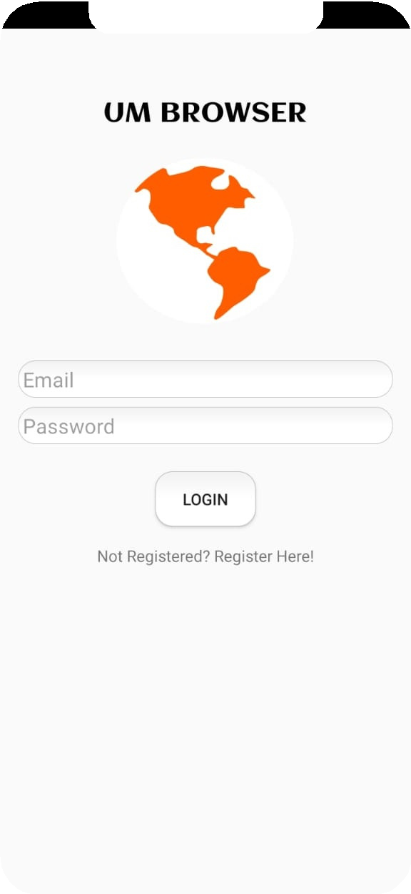
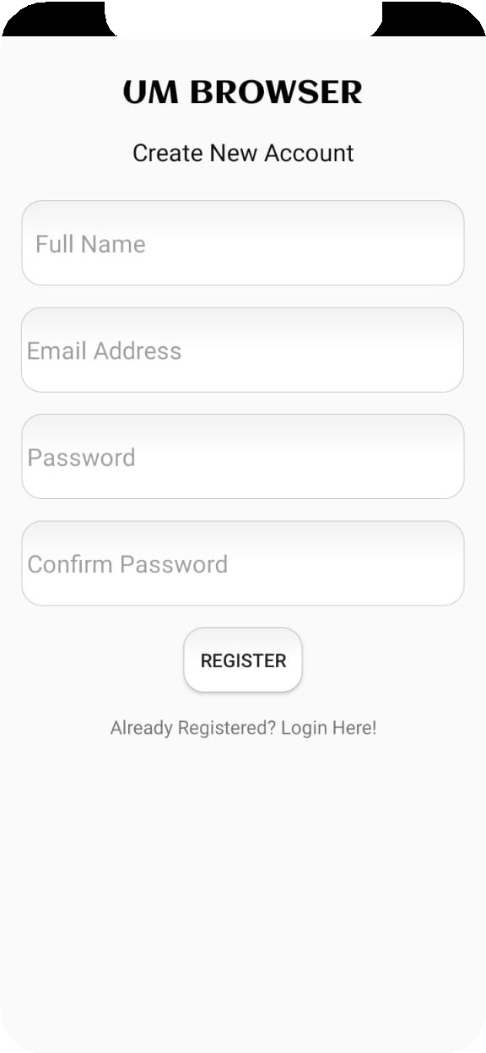
Design
Login and Registration
Users can log in with a valid email id and password. Otherwise, there is an option to register for a new account.

Slide 10
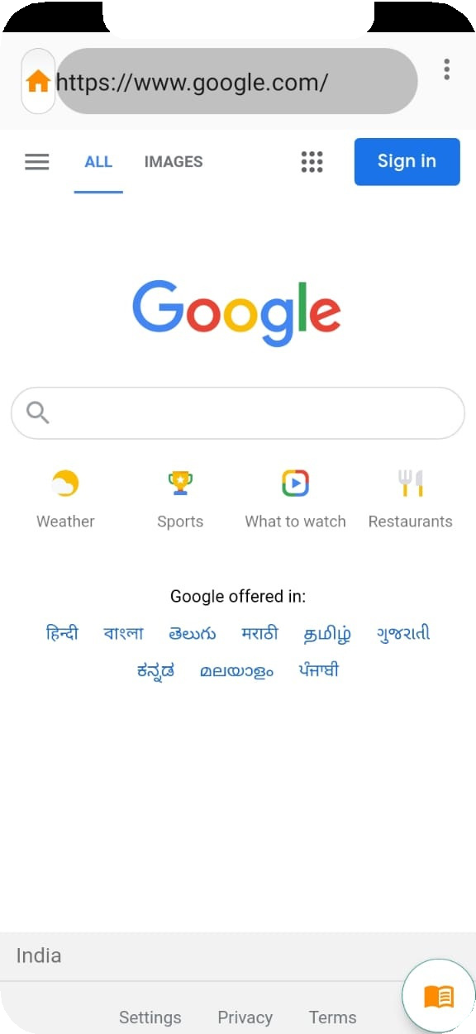
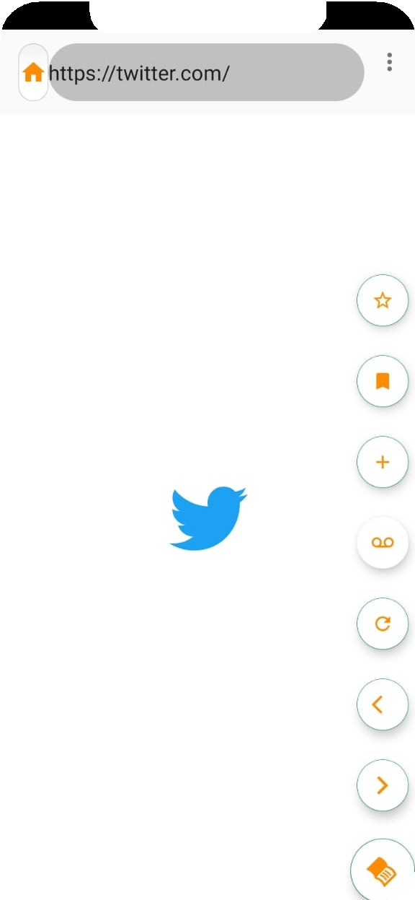
Design
Web Browser Layout
It has a URL feed Box, where one can feed the URL with or without http://. It also has necessary buttons to make your surfing easier.
Refresh Button
Forward Button
Incognito Mode
Back Button

Slide 11
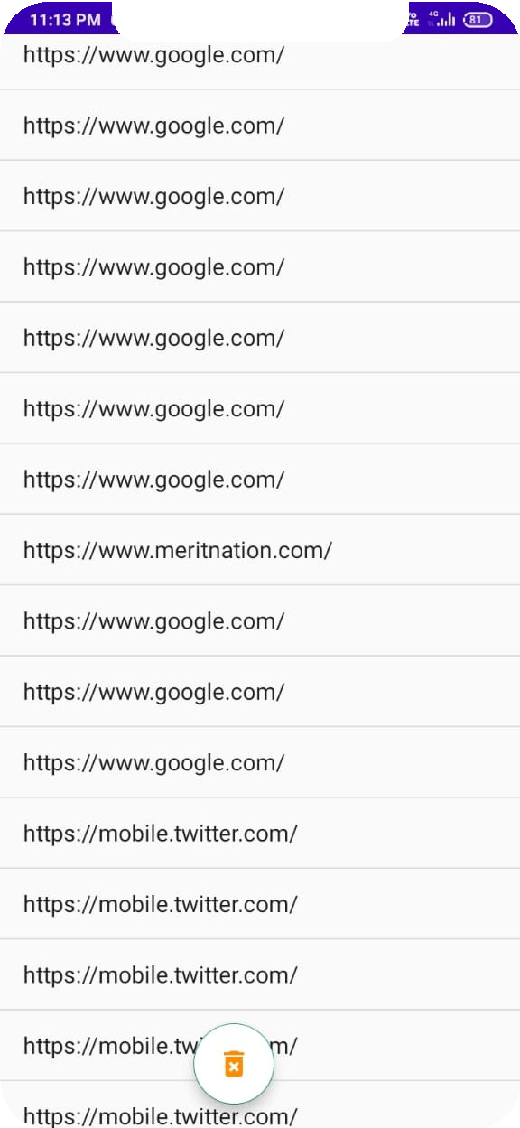
Design
History
The history section saves the URLs searched by the user. It's then saved into the external Firebase database.

Slide 12
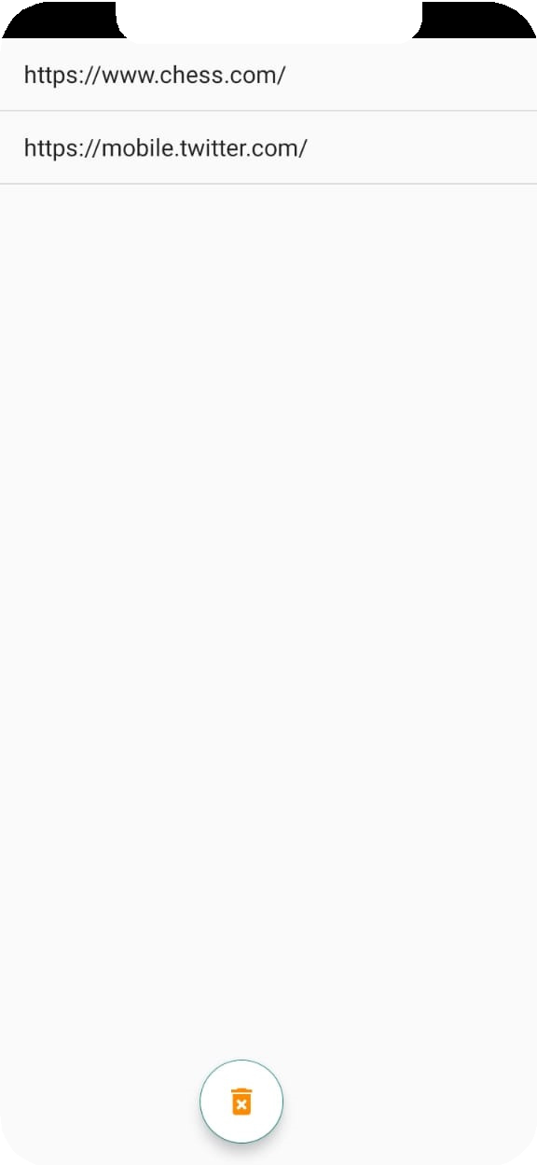
Design
Bookmarks
One can mark and save his/her most important or favorite web pages. The bookmark feature allows managing your internet library.

Slide 13
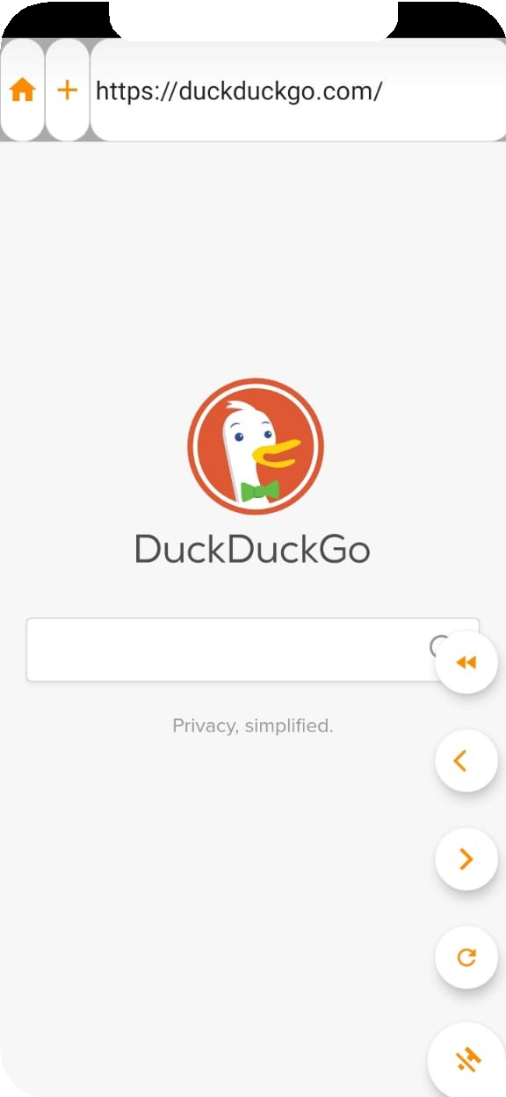
Design
Incognito Mode
Incognito Mode protects the privacy of users. In Incognito Mode, duckduckgo.com is the default search engine.

Slide 14
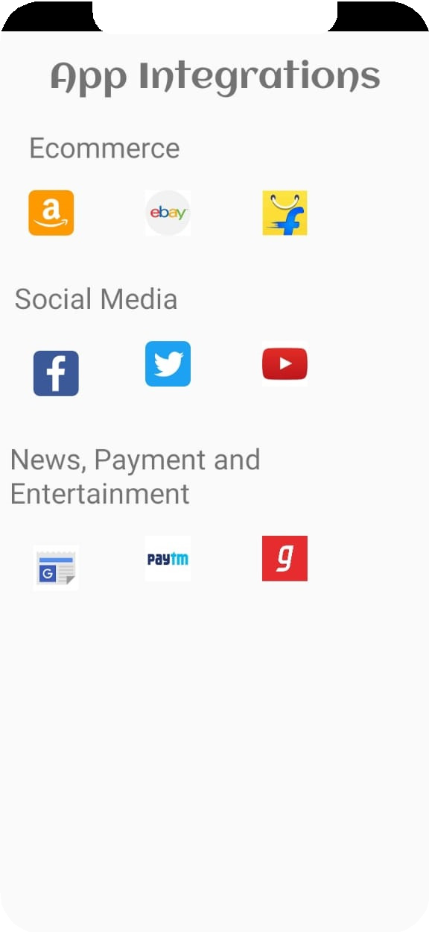
Design
Apps Integration
All popular apps like Facebook, Youtube, Amazon are integrated to provide a better user experience.

Slide 15
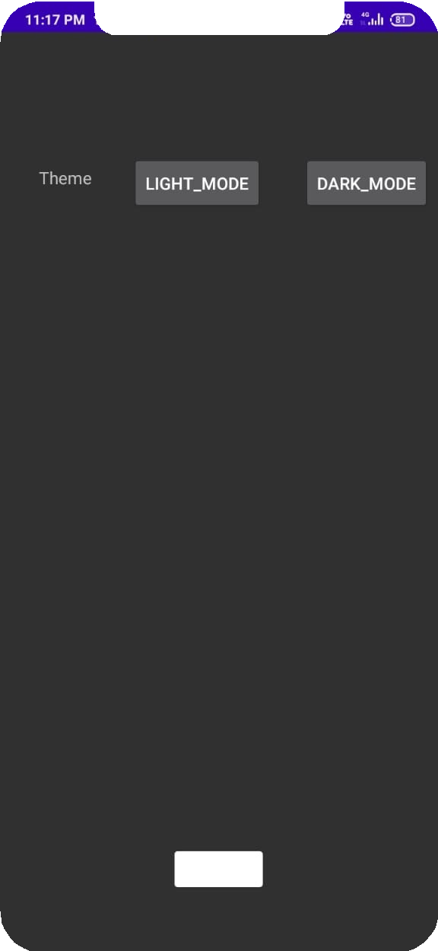

Design
Dark Theme
The browser has two Themes. Orange is the default theme. One can change it to the Dark Theme and can restore it back to the orange theme.

Slide 16

Why UM Browser?
Reason to use our browser
Other browsers gives much more smooth experiences than Um Browser, but the smooth experience comes with the cost of personal data and more RAM usage. People need a lighter web browser, rich with features, that comes with privacy controls; And all this is provided by Um Browser.

Slide 17
Future Scope
Here is the Future Scope of our Project
The success of the Web has turned the browser into a central application area for the user, and you can spend most of your day working with applications in the browser, reading mail, shopping, searching your own disk drive.
In the future, users can use the Browser to surf the internet without being getting tracked. Privacy in browser is utmost important.
UM Browser also has an apps integration feature, that can provide quick access to other popular internet services.

Slide 18
Conclusion
Here is the Conclusion of our Project
UM Browser provides all the necessary features like theme settings, incognito mode, history & bookmarks, and app integration. Other features like Password Manager and extensions will be supported in coming future. With UM Browser, you can do all kinds of web tasks like Surfing Web Pages, Working online, Watching Videos, and Music Online.

Slide 19
References
developer.android.com
stackoverflow.com
github.com
youtube.com

Slide 20


App Video

Slide 21
Thank You
Privacy is not something that we are merely entitled to, it’s an absolute prerequisite.

